Slide 1
Intensive Care Unit
Length of Stay Prediction
FCUP | L. IACD | Large-Scale Data Science | 2025/26
Catarina Fernandes up202307632 | Leonor Baía up202304808 | Pedro Ferreira 202208344

Slide 2

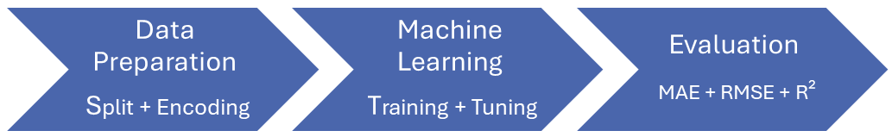
Project Overview
Large-Scale ICU Data
Visual Project Pipeline
LOS Prediction | First 24 hours only | Leakage-safe Pipeline

Slide 3
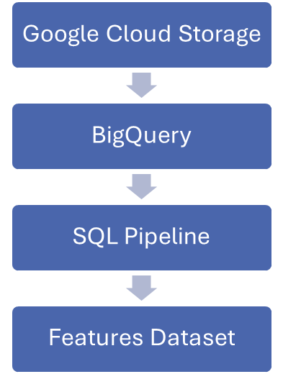
Large-Scale Data Processing
EXPERIMENT | CONFIGURATION | TABLES INCLUDED
1 | 5-Table Baseline | ICUSTAYS, PATIENTS, ADMISSIONS, CHARTEVENTS, D_ITEMS
2 | 7-Table Dataset | 5-Table Baseline + LABEVENTS, D_LABITEMS
3 | 9-Table Dataset | 7-Table Dataset + OUTPUTEVENTS, PRESCRIPTIONS
Data Processing Architecture
Experimental Dataset Configurations
330M+ Raw Events | 24h Observation Window | Feature Aggregation

Slide 4
Feature Engineering
EXCLUDED DATA
ICU Discharge Information | Hospital Discharge Information | Mortality Information | Post-Discharge Information
STATISTICAL AGGREGATIONS
Mean | Max | Min | Std | Last
CONTEXTUAL FEATURES
Demographics | Admission Data | Care Unit

Slide 5
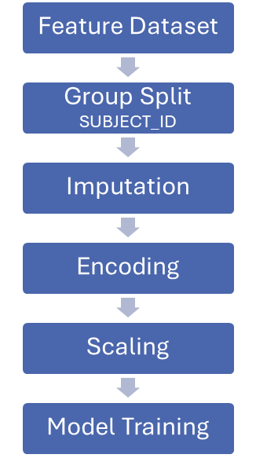
Data Preparation and Training
BASELINE MODELS SCIKIT-LEARN FRAMEWORK
Dummy
Ridge
Random Forest
Hist Gradient Boosting

Slide 6
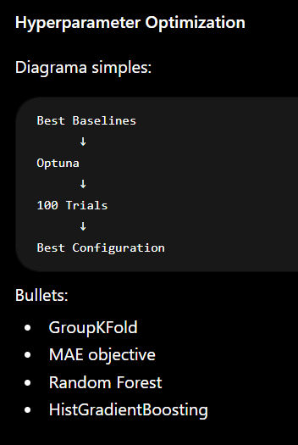
Hyperparameter Optimization

Slide 7
Results of Experiments

Slide 8
Visual Comparison Summary

Slide 9
Conclusion

Slide 10
Intensive Care Unit
Length of Stay Prediction
FCUP | L. IACD | Large-Scale Data Science | 2025/26
Catarina Fernandes up202307632 | Leonor Baía up202304808 | Pedro Ferreira 202208344

